Slide 1
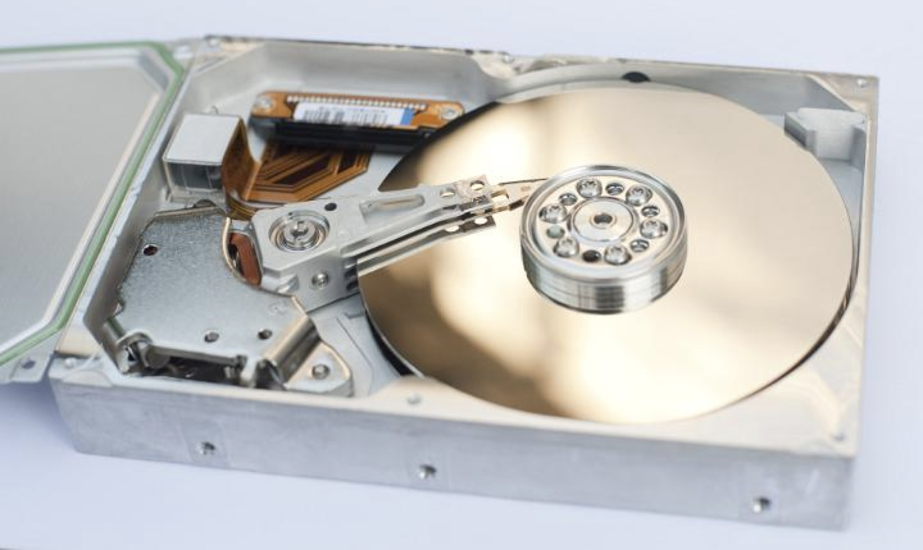
Industrial Machine Learning on Hadoop and Spark
Maks Nakhodnov, Bremen 2025

Slide 2
Distributed computing. Spark
Plan:
Spark ML

Slide 3
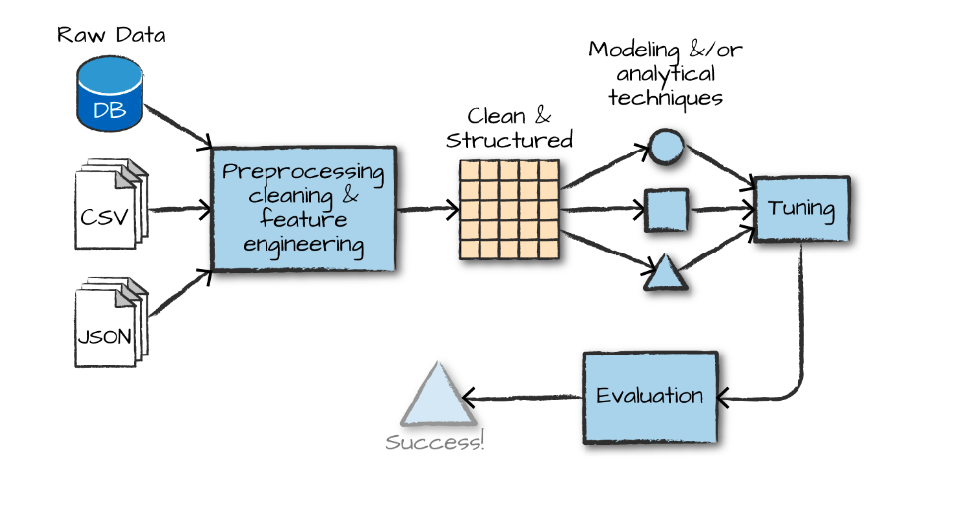
What do we want to do?

Slide 4
What does Spark ML allow you to do?
http://spark.apache.org/docs/latest/ml-features.html

Slide 5
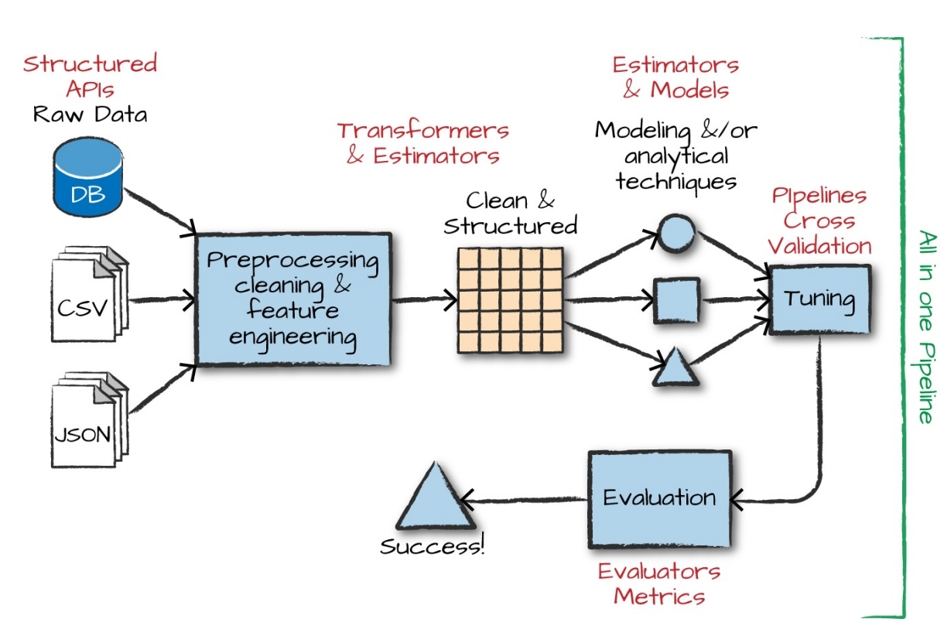
What does Spark ML allow you to do?

Slide 6
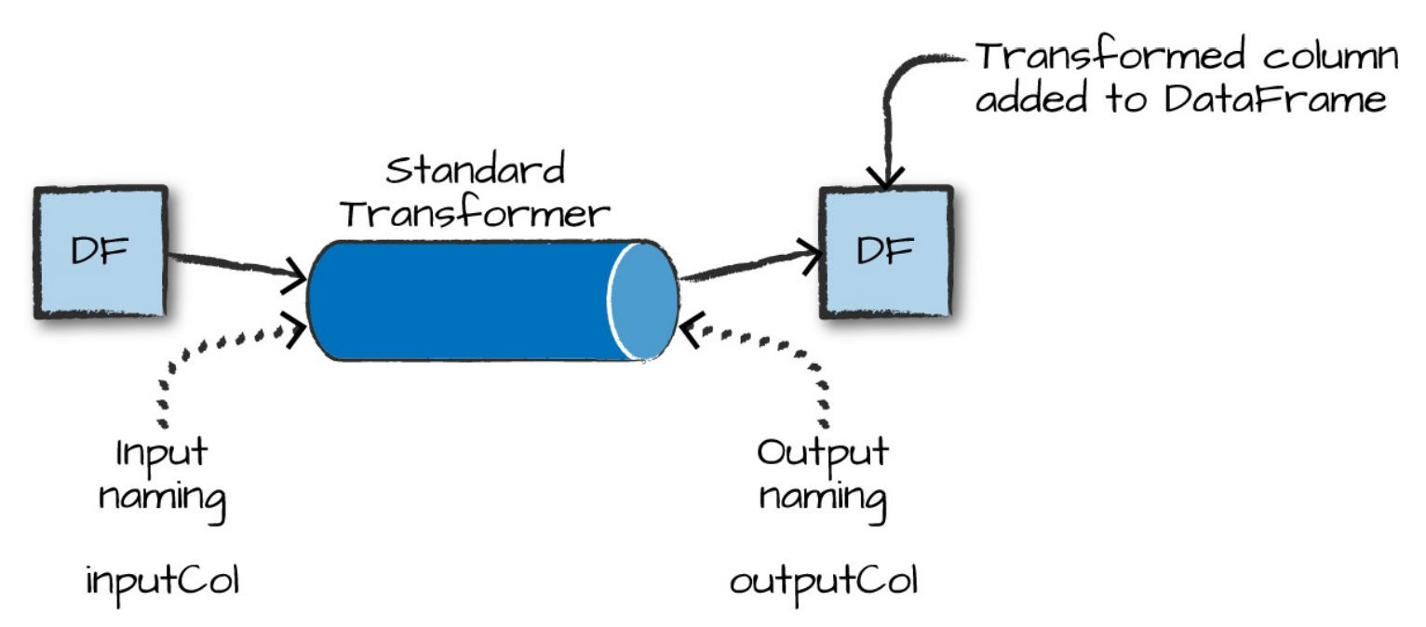
Spark ML. Transformer
Tokenizer
StopWordsRemover
n-gram
Binarizer
PCA
PolynomialExpansion
Discrete Cosine Transform (DCT)
StringIndexer
IndexToString
OneHotEncoder
VectorIndexer
Interaction
Normalizer
StandardScaler
RobustScaler
MinMaxScaler
MaxAbsScaler
Bucketizer
ElementwiseProduct
SQLTransformer
VectorAssembler
VectorSizeHint
QuantileDiscretizer
Imputer

Slide 7
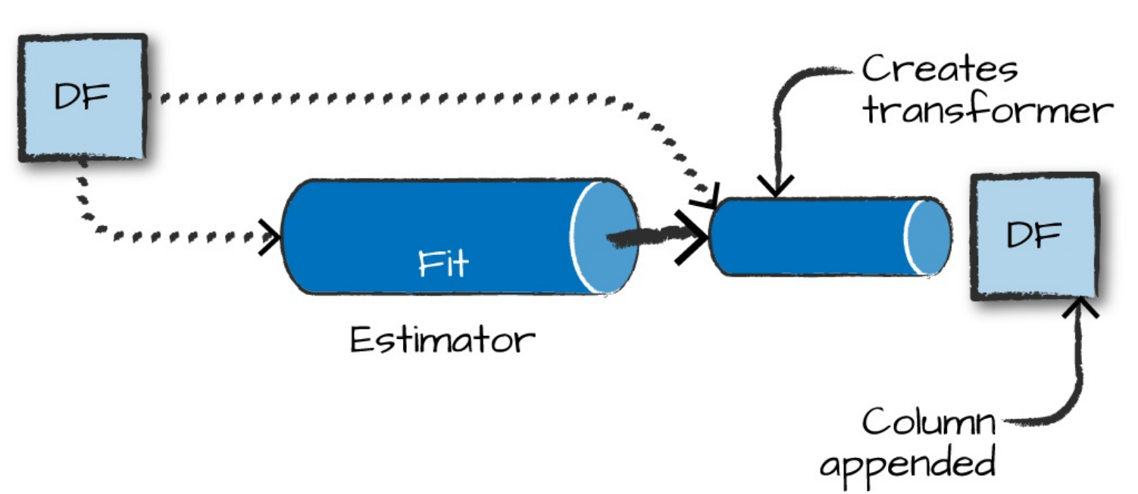
Spark ML. Estimator
KMeans
LDA
GaussianMixture
ALS
DecisionTreeRegressor
LinearRegression
RandomForestRegressor
LogisticRegression
DecisionTreeClassifier
RandomForestClassifier
NaiveBayes
OneVsRest
MultilayerPerceptronClassifier

Slide 8
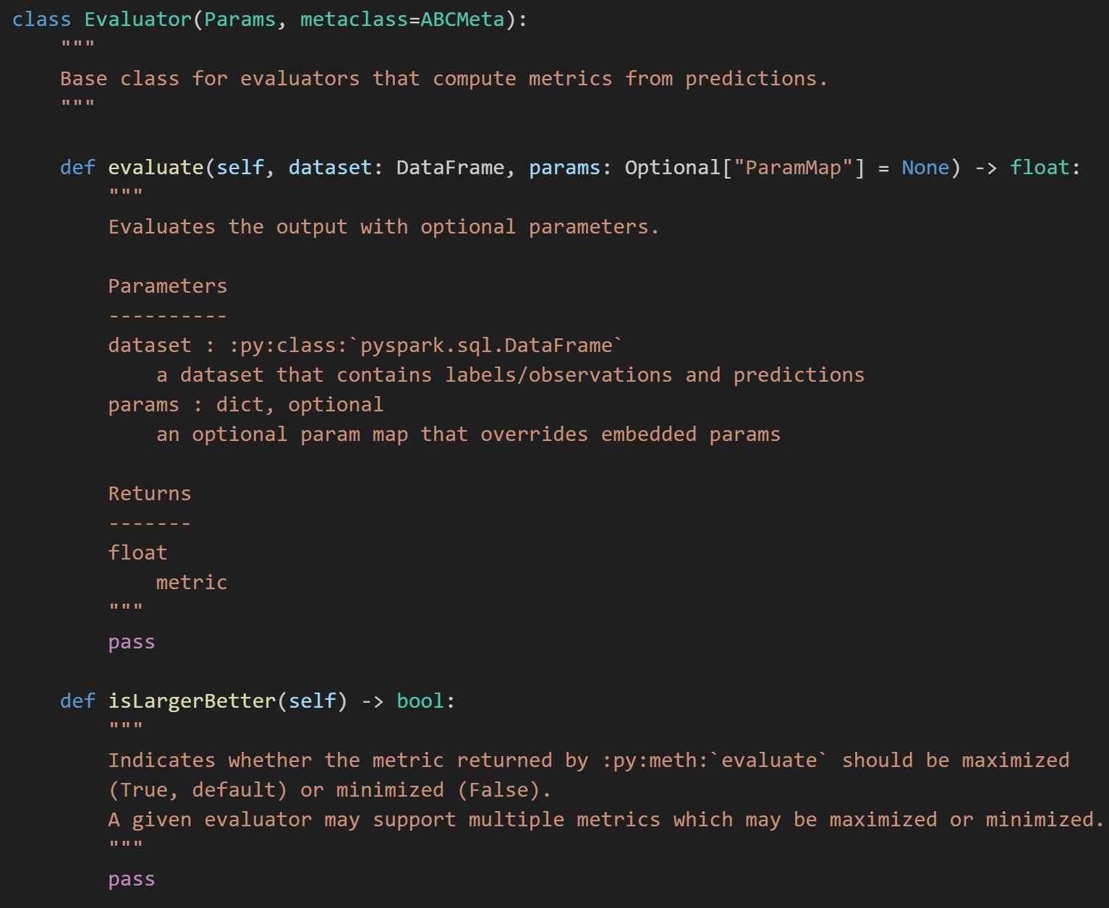
Spark ML. Evaluator
BinaryClassificationEvaluator
RegressionEvaluator
MulticlassClassificationEvaluator
MultilabelClassificationEvaluator
ClusteringEvaluator

Slide 9
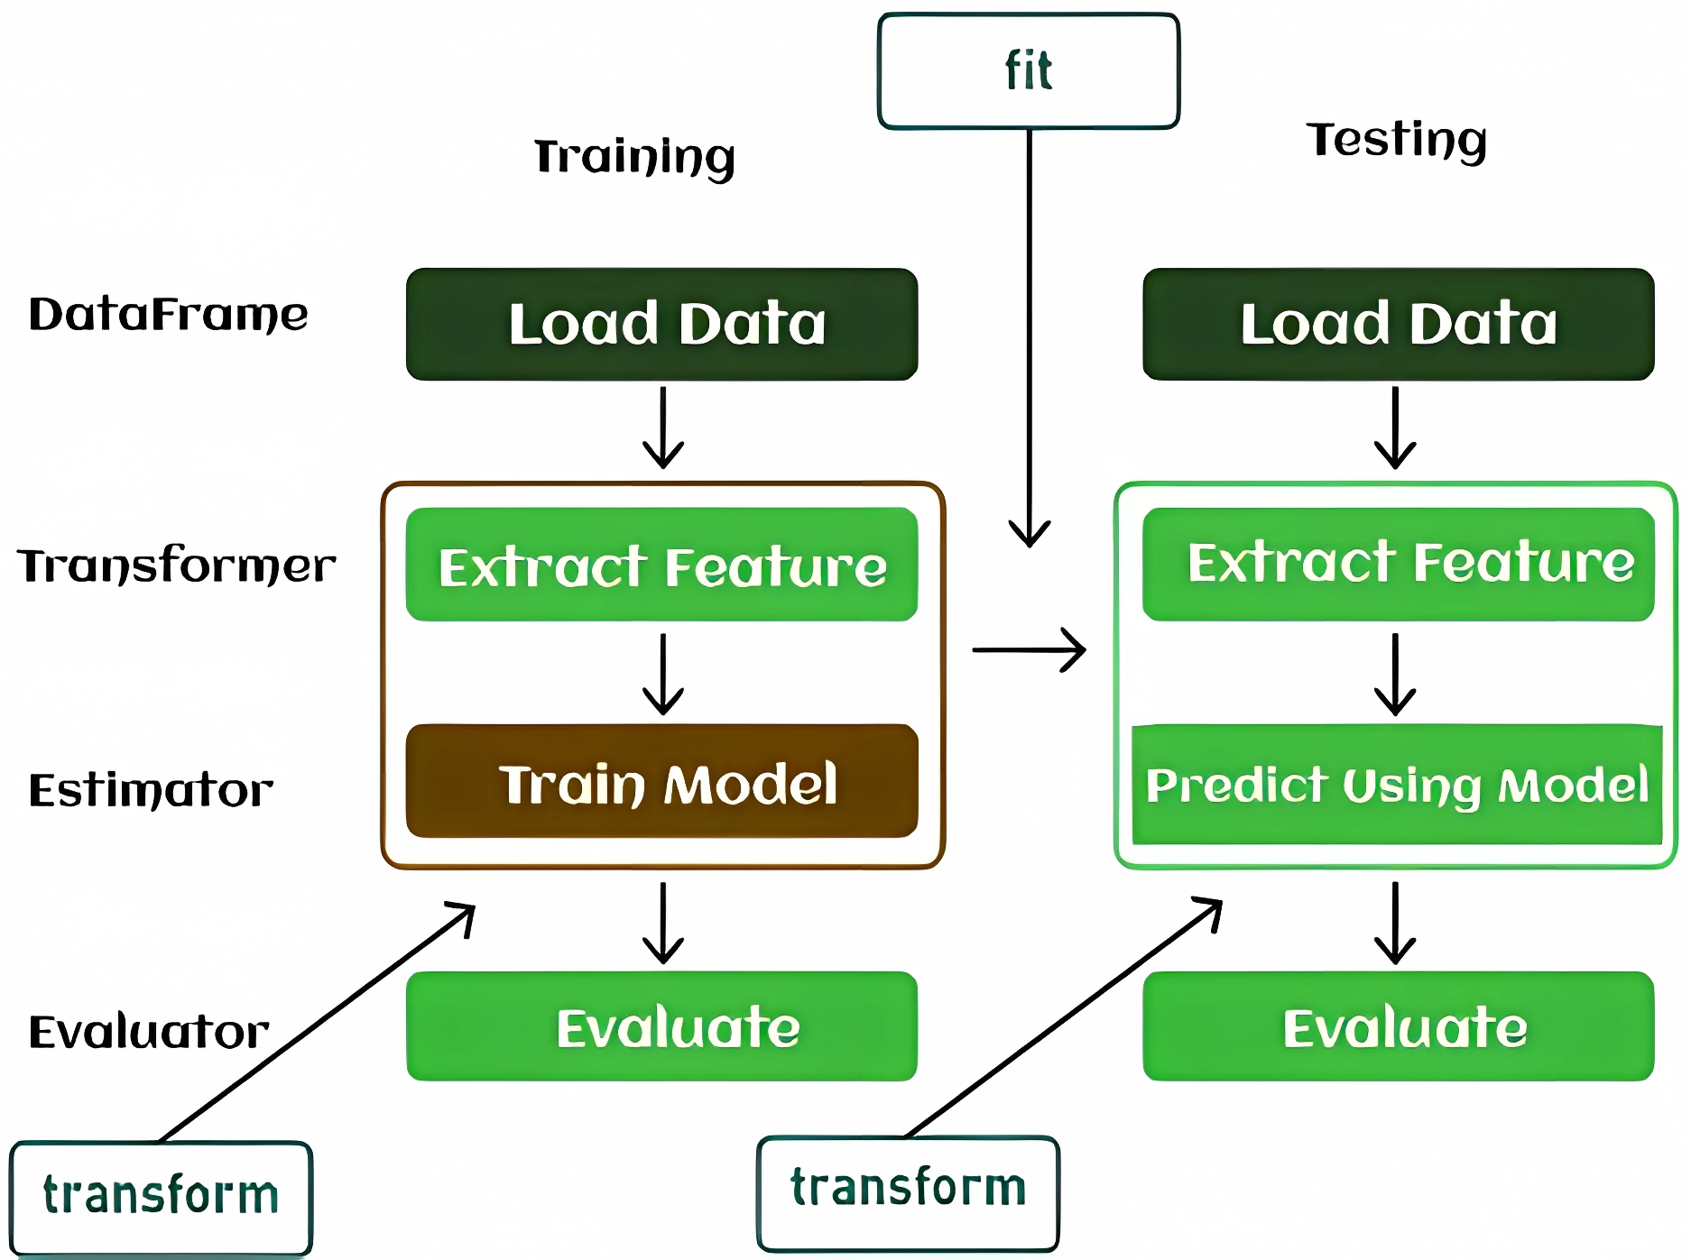
Spark ML Workflow

Slide 10
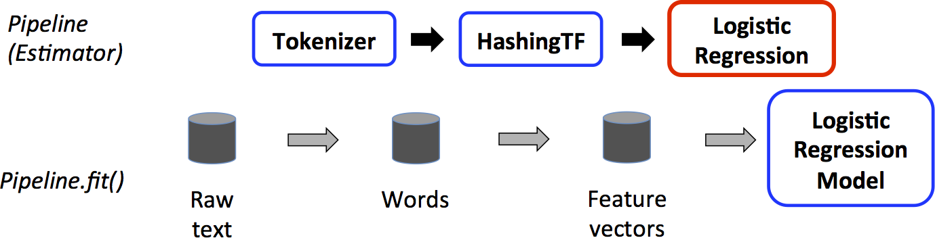
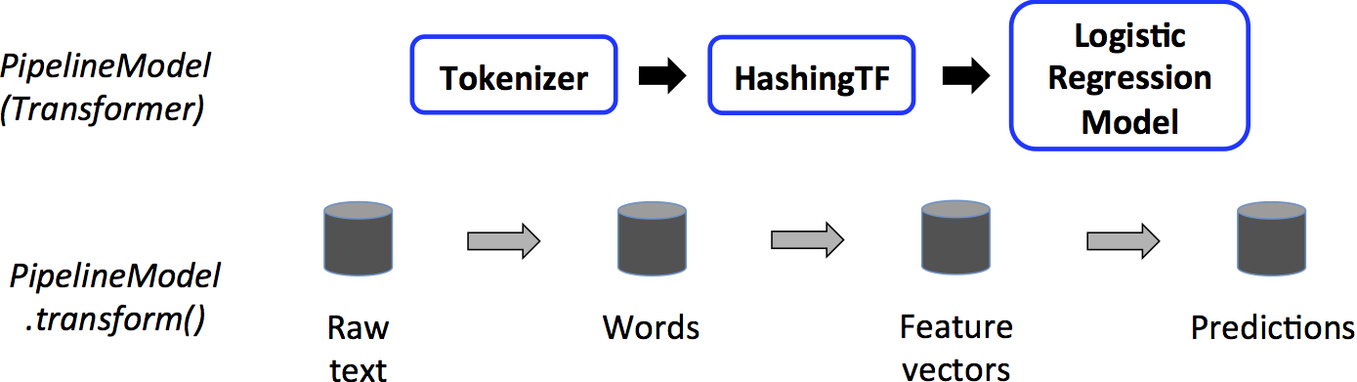
Spark ML Pipeline

